Slide 1
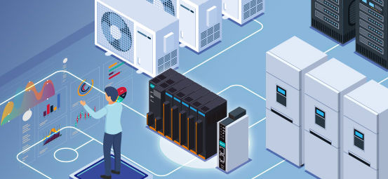

Liftians UI interface
v0.1
Notes:
Title Page (Splash Screen?)

Slide 2


Login Screen
Station #1
Your Username
Your Password
Login
v0.1
Notes:
Login Screen. Station number top right. Administration

Slide 3
Login Screen
Station #1
Sys Admin
Your Username
Your Password
Login
v0.1
Notes:
Login Screen. Station number top right. Administration

Slide 4







Sys Admin
#JohnSmith
Sys Admin
Station #1
‘non superuser’
Main Menu
Flush All
Orders
Add/Remove
User
Reboot
Server
Sys Admin
Settings
Item Search
Reports
Logout

Slide 5



Main Menu
#JohnSmith
Main Menu
Station #1
Main Menu
Replenish
Pick
Cycle Count
Logout
Notes:
Main Menu

Slide 6


Picking List
#JohnSmith
Picking List
Station #1
Main Menu
Regular Picking
Accepted
Waiting to process
Being processed
Finished
Priority Picking
 | Order No | Customer | # of Product | Qty | Order date | Status | Priority
◆ | 0000171 | The Feed | 1 | 10 | 2-5-2022 14:13:02 | Not Processed | 9
◆ | 0000178 | The Feed | 3 | 3 | 2-5-2022 15:14:22 | Not Processed | 9
◆ | 0000182 | The Feed | 14 | 14 | 2-5-2022 15:16:18 | Not Processed | 9
◆ | 0000183 | The Feed | 8 | 8 | 2-5-2022 15:17:51 | Not Processed | 9
◆ | 0000187 | The Feed | 1 | 1 | 2-5-2022 15:45:37 | Not Processed | 9
◆ | 0000190 | The Feed | 5 | 5 | 2-5-2022 16:03:09 | Not Processed | 9
◆ | 0000197 | The Feed | 7 | 7 | 2-5-2022 16:24:52 | Not Processed | 9
◆ | 0000199 | The Feed | 2 | 2 | 2-6-2022 05:34:24 | Not Processed | 9
Picking List
Picking
Operation
Start
Logout
Notes:
Picking List Page.

Slide 7
Replenishment List
#JohnSmith
Replenishment List
Station #1
Main Menu
Regular Replenishment
Accepted
Waiting to process
Being processed
Finished
Priority Replenishment
 | Billing ID | Source ID | Receiver | Receive Date | # of products | Total receive qty | Status
◆ | A3456523 | 101 | SteveH | 2-3-2022 04:13:02 | 2 | 24 | Not Processed
◆ | A2948372 | 101 | SteveH | 2-3-2022 05:14:22 | 3 | 6 | Not Processed
◆ | A3726409 | 101 | SteveH | 2-3-2022 05:16:18 | 1 | 24 | Not Processed
◆ | A1728352 | 101 | SteveH | 2-3-2022 05:17:51 | 1 | 24 | Not Processed
◆ | A1029384 | 102 | NickB | 2-4-2022 05:45:37 | 2 | 32 | Not Processed
◆ | A3826559 | 102 | NickB | 2-4-2022 06:03:09 | 1 | 12 | Not Processed
◆ | A2363418 | 102 | NickB | 2-4-2022 06:24:52 | 2 | 16 | Not Processed
◆ | A2019231 | 102 | NickB | 2-4-2022 06:34:24 | 3 | 18 | Not Processed
◆ | A4729015 | 102 | NickB | 2-4-2022 06:43:46 | 4 | 8 | Not Processed
Replenishment
List
Replenishment
Operation
Start
Logout

Slide 8
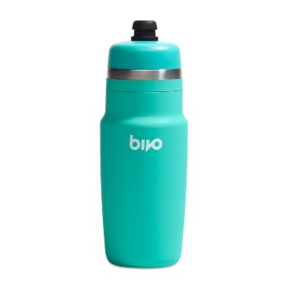
Picking Operation
#JohnSmith
Picking Operation
Station #1
Main Menu
Pod #52 A
2
item(s)
Picking List
Bivo One Bottles
Teal, 24oz
Picking
Operation
39318708617279
Change Bin
| Enter or Scan Barcode
Qty Override
Shortage
Logout

Slide 9
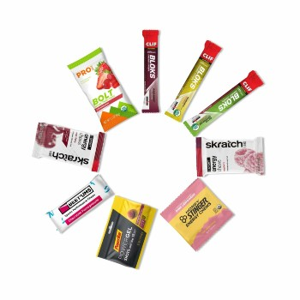
Replenishment Operation
#JohnSmith
Replenishment Operation
Station #1
Main Menu
Pod #12 B
20
item(s)
Replenishment
List
Chews - Ultimate Try Out Pack
9 Chews
Replenishment
Operation
39277026115647
Change Bin
| Enter or Scan Barcode
Qty Override
Shortage
Logout

Slide 10
Cycle Count
#JohnSmith
Cycle Count
Station #1
Main Menu
Scheduled Cycle Count
 | Rack ID | Rack Face | Rack Tier | Container No | Inventory | Product Barcode | Status
◆ | Pod 23 | A | 3 | 4 | 12 | 39209872346767 | Finished
◆ | Pod 12 | B | 2 | 1 | 3 | 39277026115647 | Not Processed
◆ | Pod 17 | A | 1 | 3 | 1 | 39310123872348 | Not Processed
◆ | Pod 52 | A | 4 | 1 | 216 | 39318708617279 | Not Processed
Cycle Count
Start
Logout

Slide 11
Item Search
#JohnSmith
Item Search
Station #1
Main Menu
Enter or Scan Barcode
216
in stock
Search Item Name
Item Search
Bivo One Bottles
Teal, 24oz
39318708617279
Logout

Slide 12



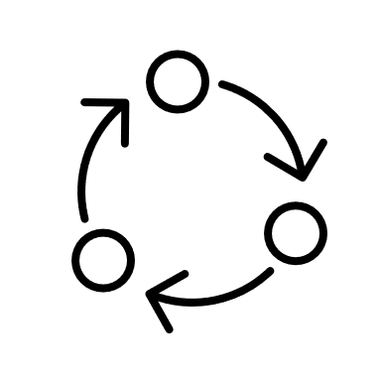

Reports
#JohnSmith
Reports
Station #1
Main Menu
Top SKUs
Productivity
Bot Activity
Reports
Replenish
Activity
Server Status
Cycle Counts
Logout

Slide 13
Settings
Settings
Station #1
Main Menu
Settings
Logout

Slide 14
Template Page
Testing
Station #1
Main Menu
Blank Button
 | Order No | Customer | # of Product | Qty | Order date | Status
◆ | 0000171 | The Feed | 1 | 1 | 2-5-2022 14:13:02 | Not Processed
◆ | 0000178 | The Feed | 3 | 3 | 2-5-2022 15:14:22 | Not Processed
◆ | 0000182 | The Feed | 14 | 14 | 2-5-2022 15:16:18 | Not Processed
◆ | 0000183 | The Feed | 8 | 8 | 2-5-2022 15:17:51 | Not Processed
◆ | 0000187 | The Feed | 1 | 1 | 2-5-2022 15:45:37 | Not Processed
◆ | 0000190 | The Feed | 5 | 5 | 2-5-2022 16:03:09 | Not Processed
◆ | 0000197 | The Feed | 7 | 7 | 2-5-2022 16:24:52 | Not Processed
◆ | 0000199 | The Feed | 2 | 2 | 2-6-2022 05:34:24 | Not Processed
◆ | 0000203 | The Feed | 11 | 11 | 2-6-2022 05:43:46 | Not Processed
Date Menu
Settings
Item Search
Reports
Logout

